Slide 1


Advanced Object
Oriented Programming
2110030323-Rama Kowshik
2110030291-Shaik Farhaan
2110030295-Venkata Suhas

Slide 2
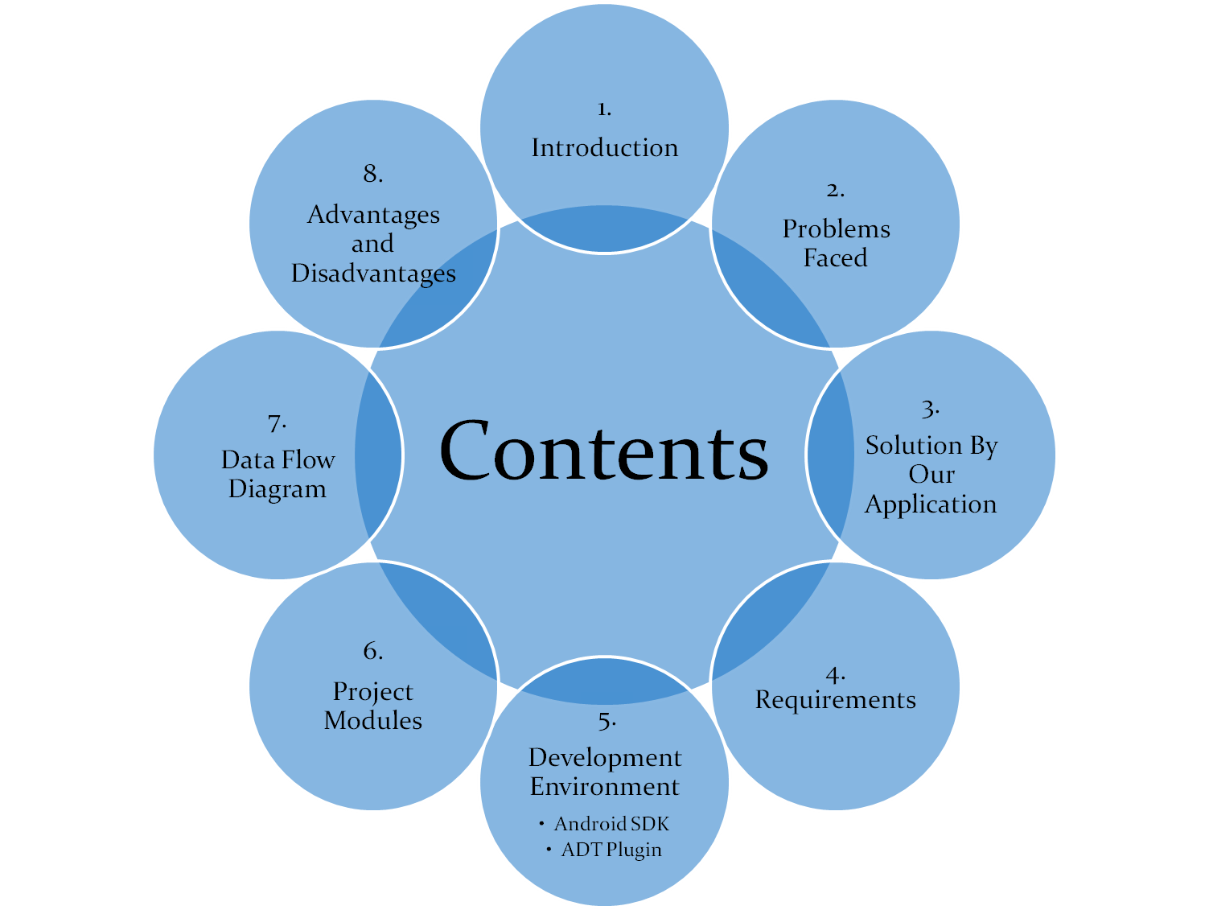

Slide 3
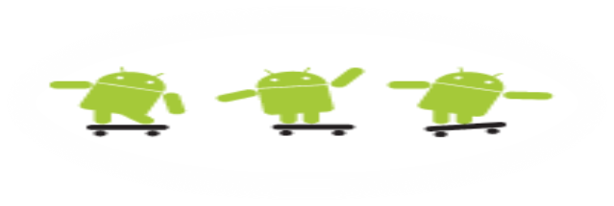
Introduction
“KLH Bus Tracking Application” is an application for Smart phones that works on Android Operating system.
This application uses the GPS function.
This application uses a variety of technologies to track the locations of buses in real time.
Notes:
This application at a specific pickup point will send the current location of the bus to students when they request.
This app generate predictions of bus arrivals at stops along the route.

Slide 4
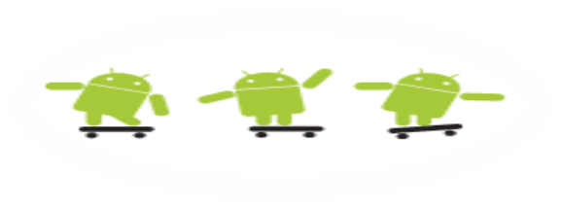
Problem Faced
In the daily operation of bus transport systems, mainly that of buses, the movement of vehicles is affected by different uncertain conditions as the day progresses, such as :
  traffic congestion
  unexpected delays
  Irregular vehicle-dispatching times
  other incidents.
Many students are late for classes because they decide to wait for the bus instead of just simply using a alternate transportation.

Slide 5
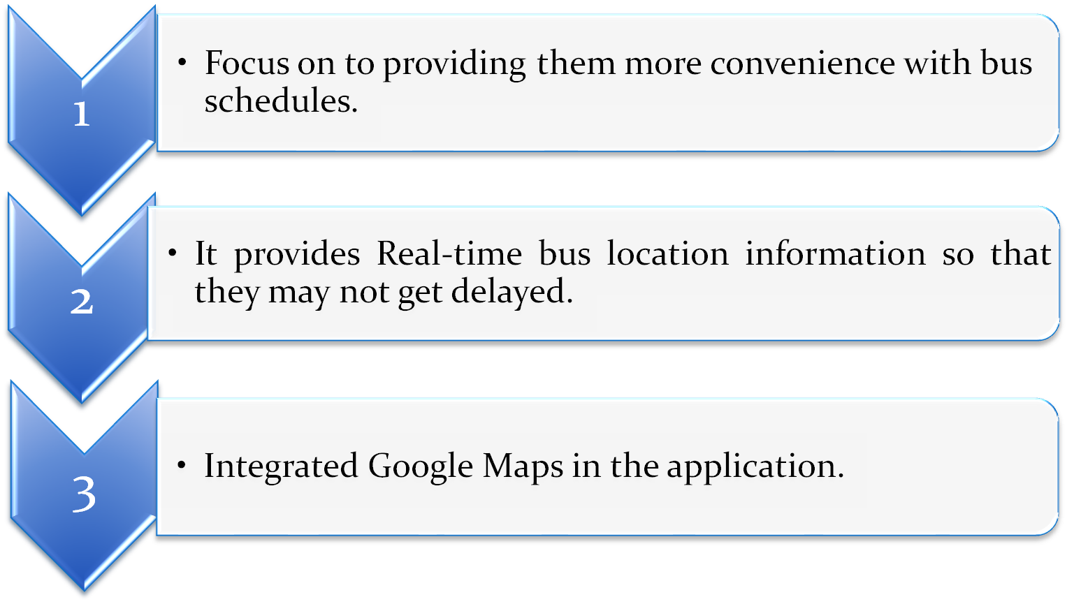
Solution by Our Application

Slide 6
Development Environment
The proposed system requires Android Studio that is an open source software development environment.
Eclipse consists of an Extensible plugin system and an IDE.
The Android project has been developed in the Android Studio 4.0, as it has plugins that are mainly used for Android.

Slide 7
ANDROID SDK
Integrated Development Environment (IDE) is used in Android development in order to make it more straight forward and quick.
It has been recommended for the developers because of its simplicity in working.
Android is basically a multitasking platform.
These applications can work simultaneously with other applications because of multitasking ability of the Android platform.

Slide 8
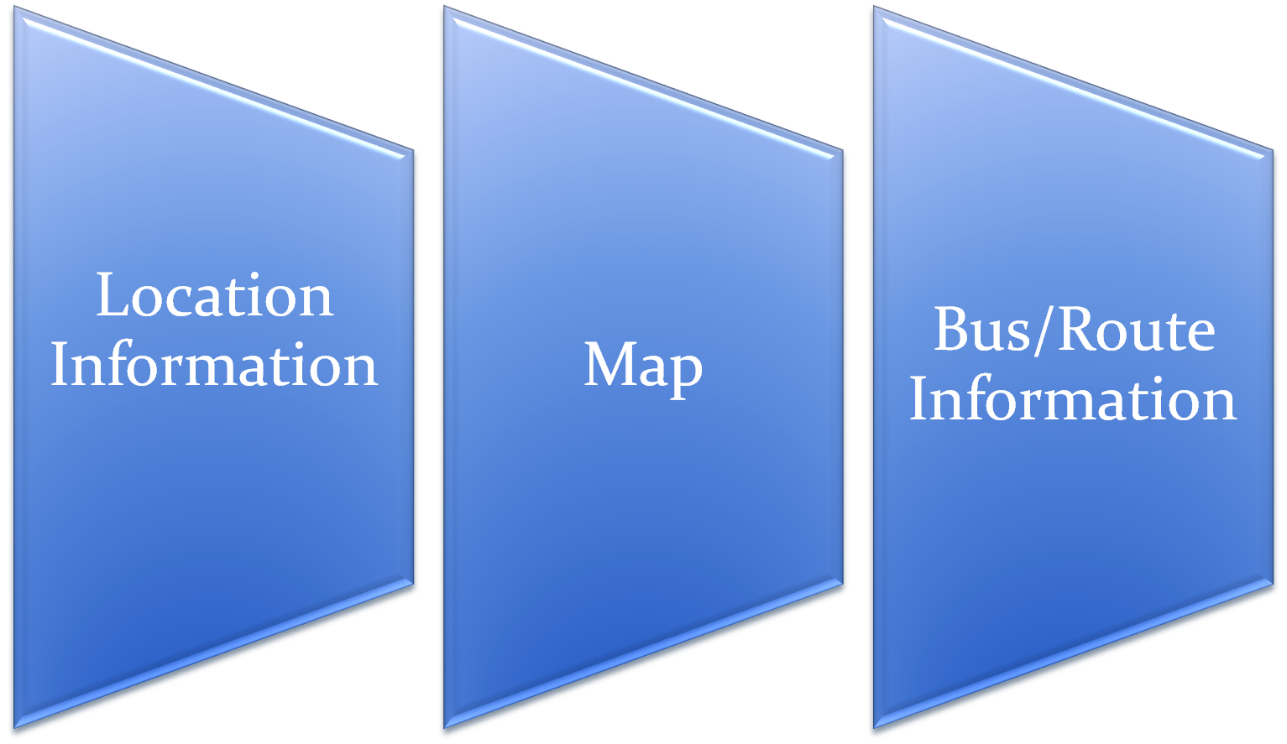
Project Modules

Slide 9
Module 1- Location Info
This module depicts the process of selection of Bus no and presenting the current location of the Bus.
TECHNOLOGY APPLIED:
  GPS – Global Positioning System.
  Client-Server Technology.

Slide 10
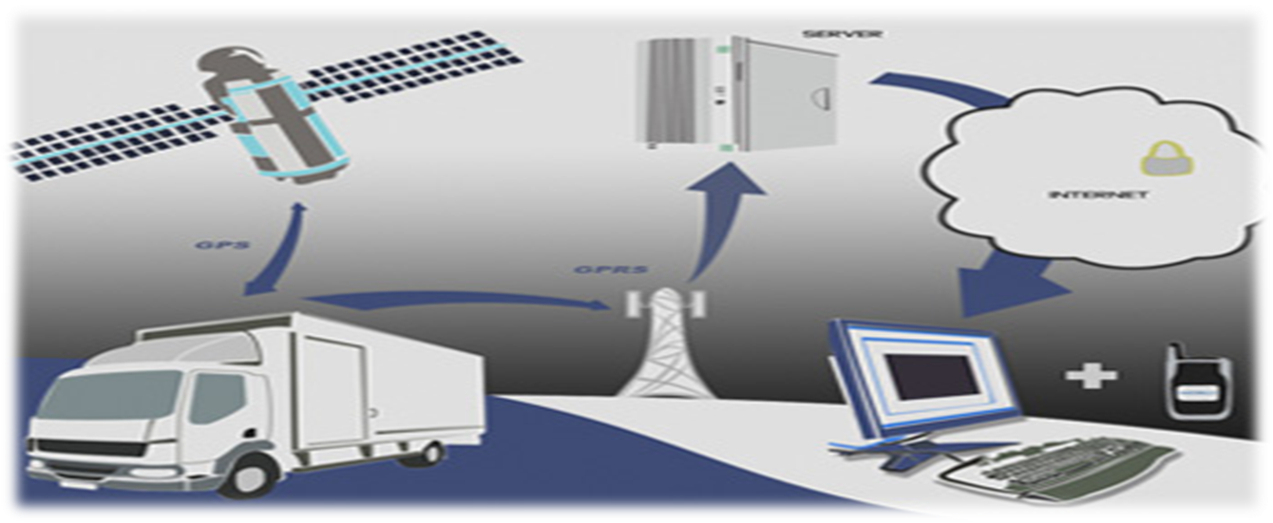
GPS- Global Positioning System
It is a technology where satellites send down radio signals which GPS units and receivers use to work out their current location (which is shown by latitude, longitude and elevation).
GPS works like this:
  There are 24 working satellites circling the globe at any given moment. A GPS navigator or GPS tracker searches for the transmission signal from at least three satellites

Slide 11
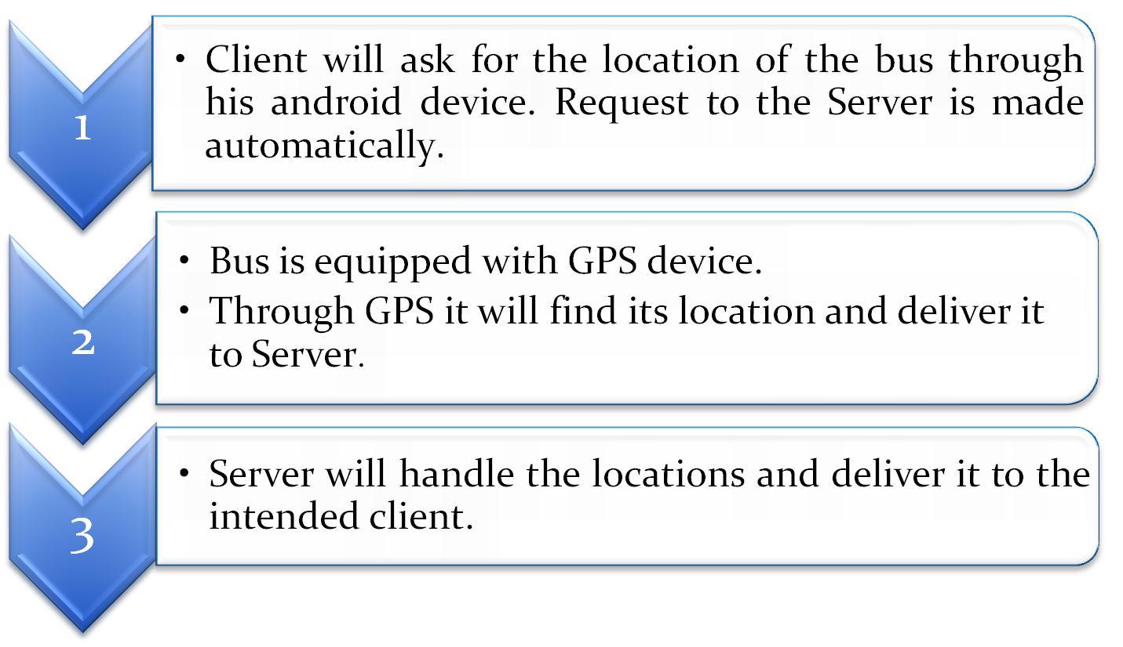
Client- Server Working

Slide 12
Data Flow Diagram
Requset Location
System
Send location
User
Server
Send Location
Request Location
DataBase

Slide 13
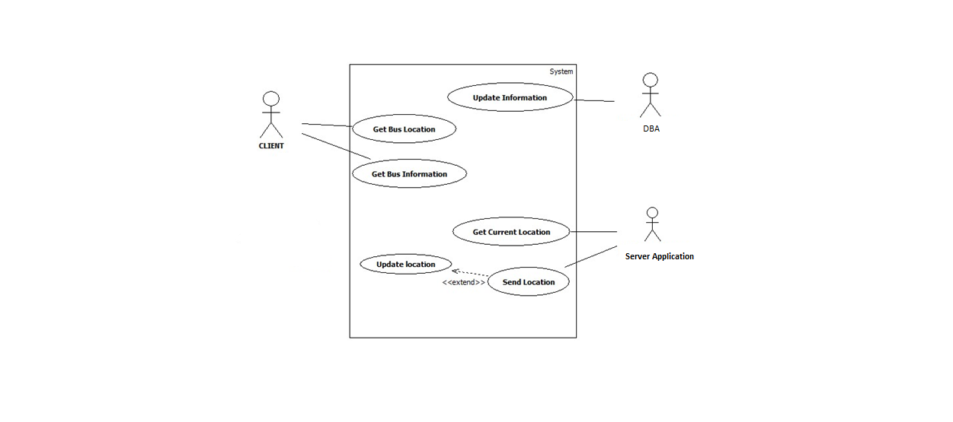
Use Case Diagram :

Slide 14
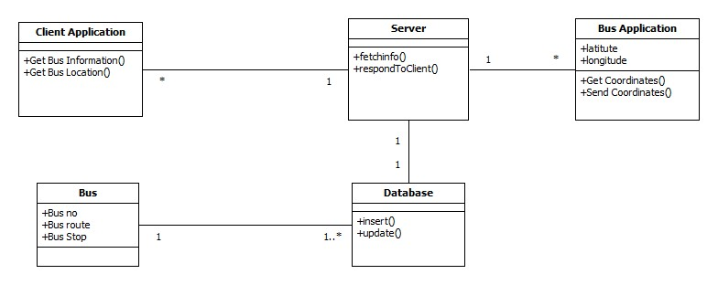
Class Diagram :

Slide 15
Applications
Commonly used by fleet operators for fleet management functions such as fleet tracking, routing, dispatch, on-board information and security.
Popular in consumer vehicles as a theft prevention and retrieval device.
Asset tracking: Companies needing to track valuable assets for insurance.
Notes:
Field service management: Companies with a field service workforce for services such as repair or maintenance, must be able to plan field workers’ time, schedule subsequent customer visits and be able to operate these departments efficiently.
Field sales: Mobile sales professionals can access real-time locations.
Trailer tracking: Haulage and Logistics companies often operate Lorries with detachable load carrying units.

Slide 16
Advantages
Reduces traffic in clumsy areas.
Makes people to avoid unexpected delays.
Improves scheduling of vehicle timings.
Disadvantages
GPS based location system may not work properly during inappropriate weather conditions.

Slide 17


